Slide 1

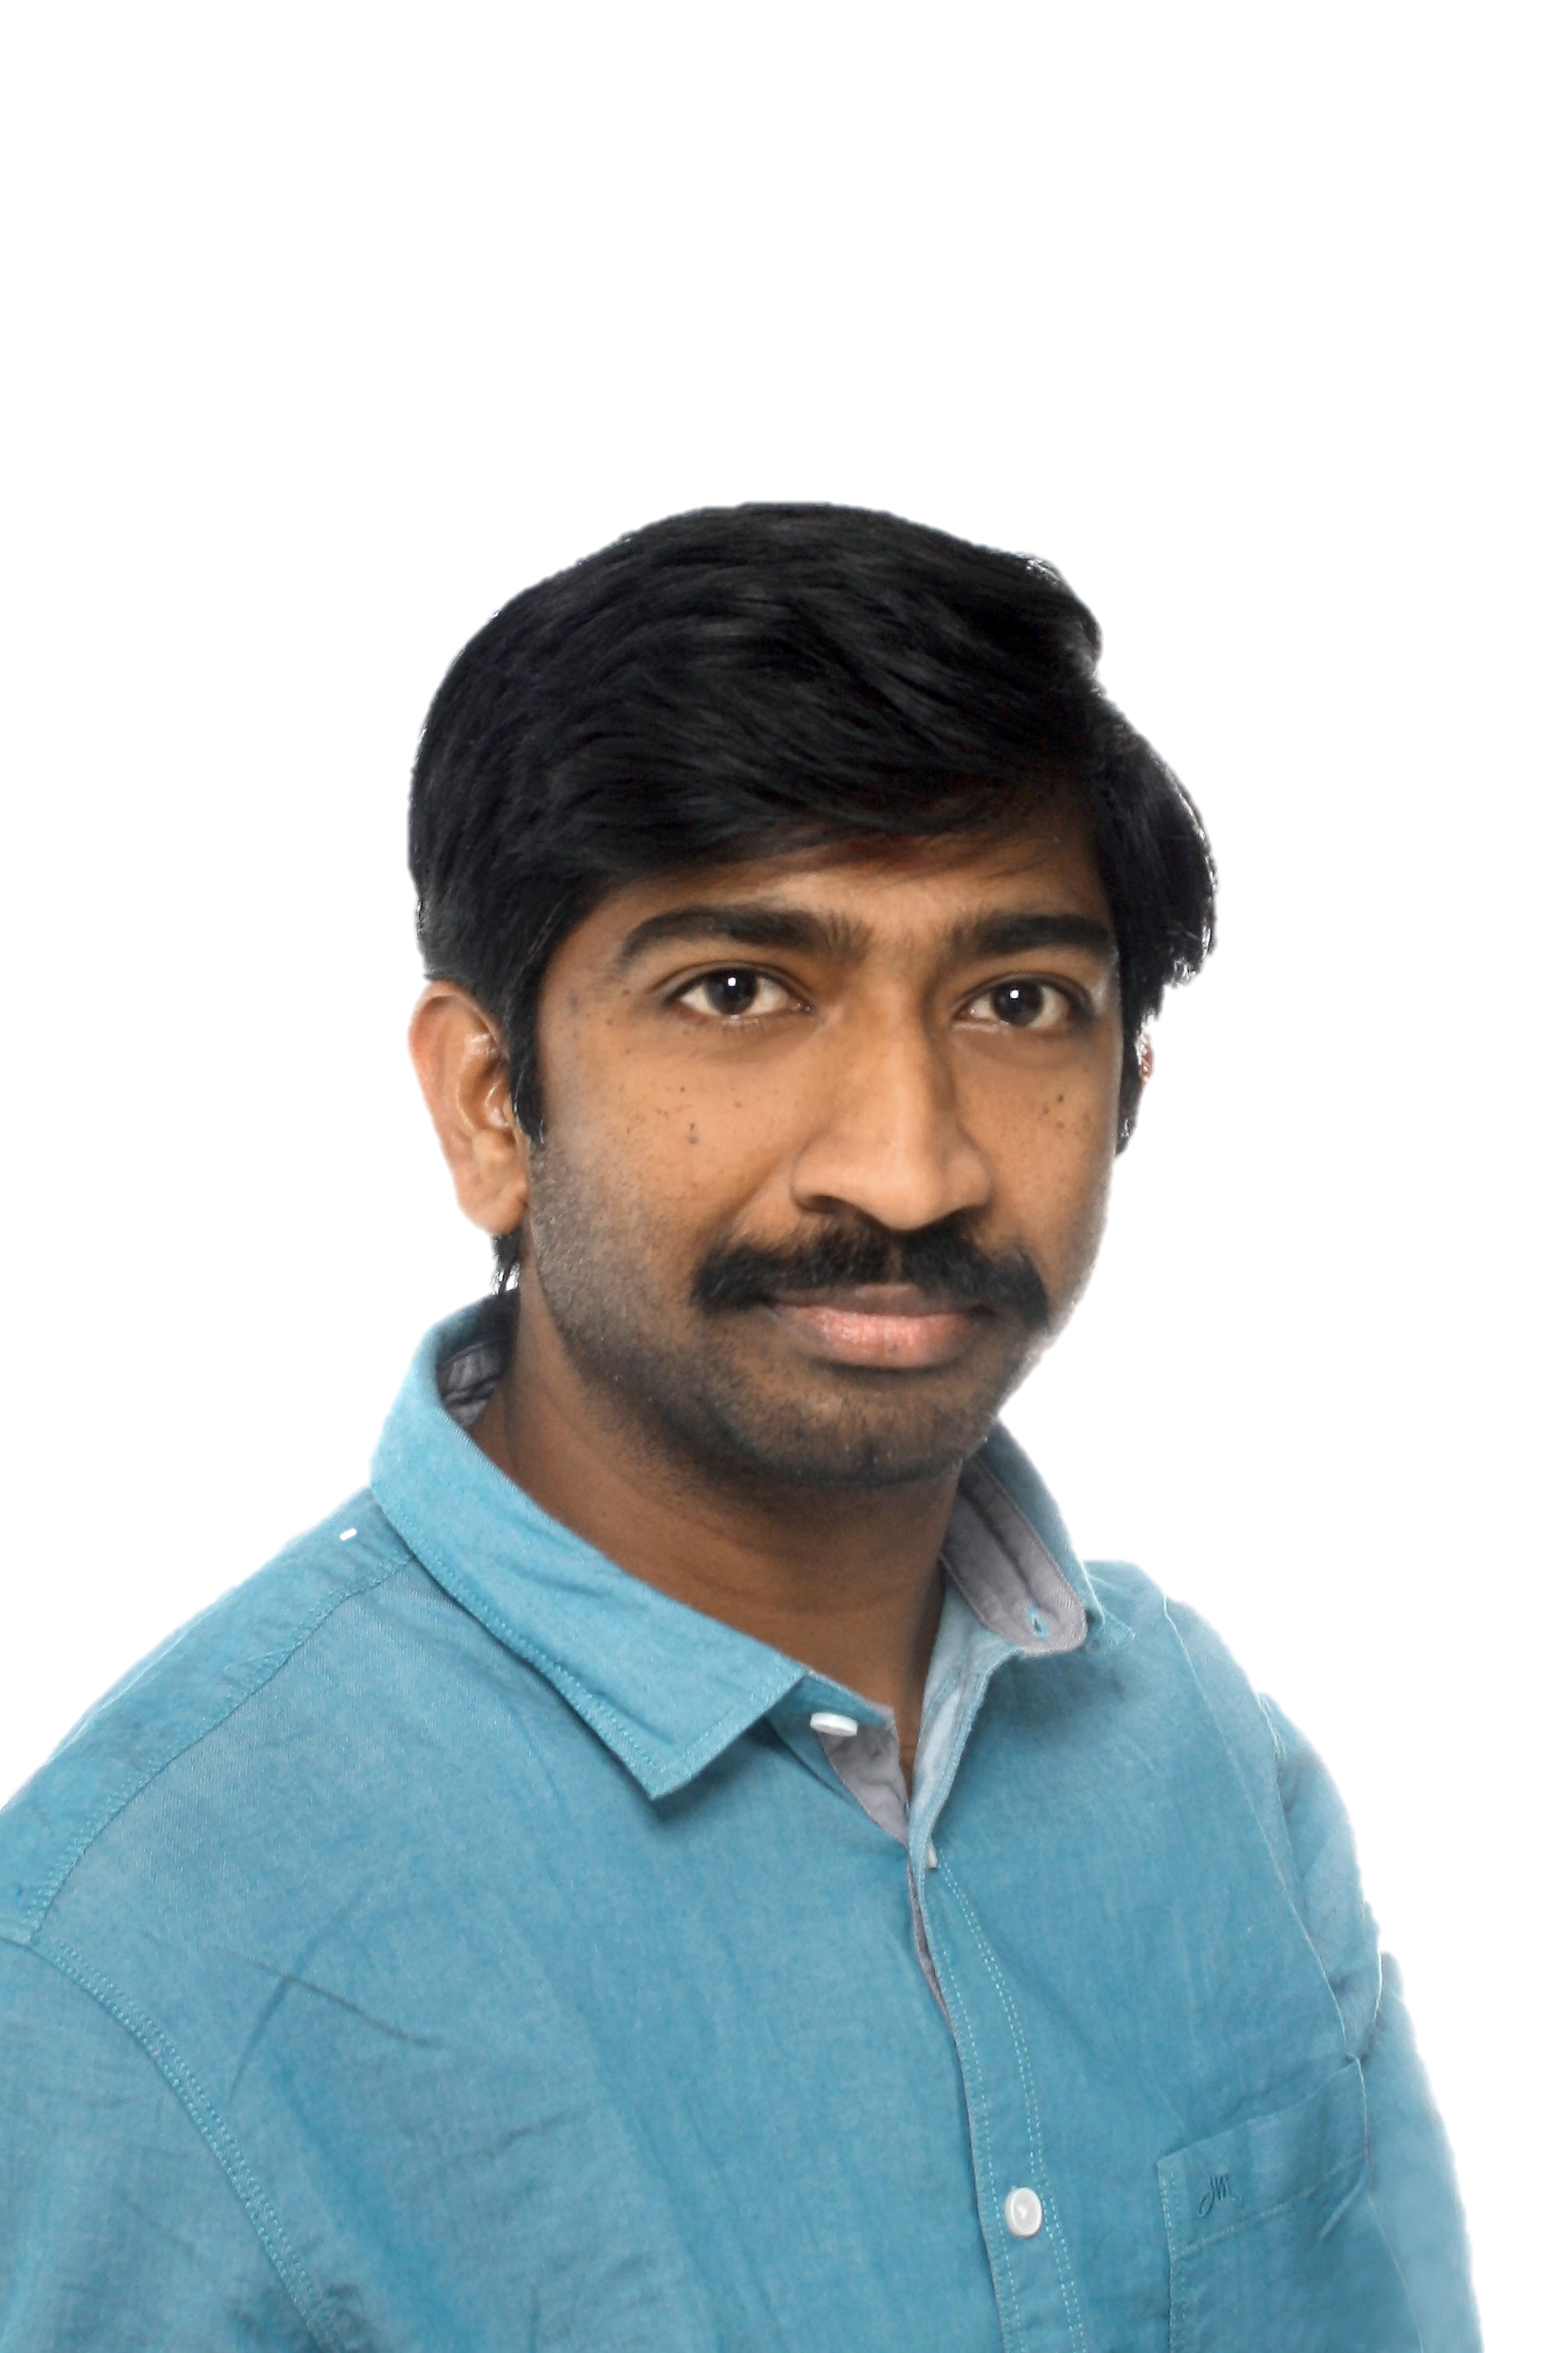

Krishna Annugula
IT Project Management IT00DV53-3001
Final Individual Assignment
Feedback from peers
Self-Evaluation
Competence Development plan

Slide 2
Slide 1
What I Learned in IT Project management course
In class decisions
With in few mints, need to discuss and conclude with different teammates.
Appreciations
Appreciating the peers who made your day good in class sessions.
Group Assignment
Discussing with different members of groups and sharing the ideas.
Collaboration
This is must , how to collaborate and move forward with the peers.
Who am I.
Exploring My self to the outside world.
Talking to different nationalities and getting the feedback from them.
Learning Together
Even though we make numerous hot discussions finally standing on the single point of agenda.

Slide 3

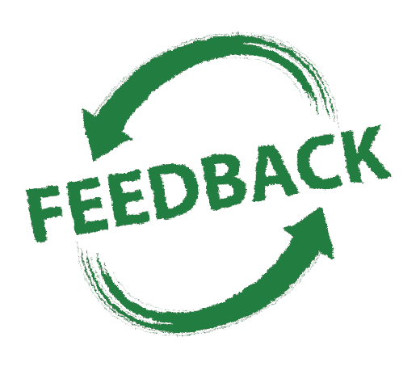
My peers call me as
Encourager / Checker
(Talkative, Full of good ideas & solutions, Happy)
Received about 5 responses
Most of positive and a bit negative feedback
Impression
Can you tell me what kind of impression I have delivered to you as a team member?
Active participant in the group.
Talkative, happy, keeps promises, good team player
Positive impression as an accurate, well understanding team member!
An excellent team member with your positive attitude
Does not utilize your expertise fully
Reason for Impression
Can you explain details what I did to leave you with that impression of me?
Krishna is good with little details as well, he has an eagle eye
I felt that your ideas were good, and you worked hard to achieve the excellent result.
Shared his views and wanted to participate to the given tasks.
Krishna is a very easy-going person who enjoys teamwork and contributes effectively at any stage
I had more expectations from you, but I did not see those fully in our teamwork.

Slide 4
Observation
What did I do that you feel was less effective?
I never felt that you're less effective, you have contributed your part.
Krishna likes to ask questions and good ones that awake the team and keep them motivated and ongoing.
Split it to all of us and then do the implementation
A common view might not have been formed yet before the actual execution started
There was some hesitation in accepting the changes needed for our project scope
Suggestions
How do you feel that I could best develop my behavior in this area?
I worked with many professionals, and I do believe strongly Krishna is one of the tops I have met.
It has been very pleasure to work with you. You share your ideas and listen to others also
Bring your overall experience to define the solution/output.
Seek for a wider consensus among the group
look at bigger solution & bring your experience together

Slide 5
Overall
I can strongly say that overall, I received a very good and positive feedback
you were so helpful in finding usefulness in some of my overly complicated ideas in our Prima team assignment.
If I would be in a position to improve Krishna talent, I would work hard to promote him to a harder and higher position target in the company
I am an easy-going guy with a positive attitude, full of hopes for the future, I love taking responsibility but not bossism.
I take positive feedback as my pleasure and negative feedback, it makes me more accountable to grow faster.

Slide 6


SELF EVALUTION
STRENGTHS
Leadership skills
Talkative
Positive Attitude
Communication
Enthusiasm to learn
Active participation
WEAKNESSES
Multitasking
Self criticism
Impatience
Too much detailed -oriented
Over responsible
Presentation skills

Slide 7
Slide 3
This flower shows my Core Competence and current way of working ,
The idea of below flower was created using the pdf shared in assignment.
I am more interested in sharing ideas and new ways of doing things.
Actively seeks to apply technology to appropriate tasks.
My motivation to my colleagues is grow and work together, achieve the goals faster.
Develops clear goals that are consistent with agreed strategies.
Archiving the knowledge for self-use don’t make me a leader,
Sharing the knowledge with your peers can become a servant leader.
Meets timeline for delivery of product or services to client.
Establishes and maintains productive partnerships with clients by gaining their trust and respect.
Keeping my skills up-to-date in professionally and personally.
Time to time seeks feedback to learn and improve fast.
Takes ownership for all responsibilities and honors commitments.
I love to participate and solve complex solutions.
I really enjoy appreciations from peers and managers.
Demonstrates openness in sharing information and keeping people informed.
Takes calculated risks on new and unusual ideas; thinks outside the box.
Keeps abreast of available technology

Slide 8


CORE COMPETENCIES
Below is the most focused core competencies in coming future
Commitment to Continuous Learning
• Keeps abreast of new developments in own occupation/profession.
• Actively seeks to develop oneself professionally and personally.
• Contributes to the learning of colleagues and subordinates.
• Shows willingness to learn from others.
• Seeks feedback to learn and improve.
Keeping my skills up-to-date it can give me the confidence to handle any tasks that my employer expects me to perform, Professional development courses can help me expand my professional skill set, learn something new, or even earn academic credit like right now I am doing masters which to put towards a degree.
Professional journals and trade magazines are one of the best resources to keep abreast of technology developments in the industry and to track changes in best practices. By reading these regularly, I can keep a running list of the rising areas where I might improve my knowledge.

Slide 9
CORE COMPETENCIES
Professional journals and trade magazines are one of the best resources to keep abreast of technology developments in the industry and to track changes in best practices. By reading these regularly, I can keep a running list of the rising areas where I might improve my knowledge.
Collaborating with peers and receiving ad-hoc feedback is also one of the best ways to learn from mistakes.
Rather than solving mistakes when it happens, it is better to practice continuous learning, which gives me more far-reaching gesture.

Slide 10

Thank you

